Slide 1



Choosing the best language for your machine learning solution: From R to Python
BRK2019
Daniel Schneider – Principal Program Manager (Azure ML)
David Smith – Principal Cloud Developer Advocate
Demo code at: http://aka.ms/brk2019

Slide 2
Agenda
studio, datasets, notebooks, notebook vm, R

Slide 3
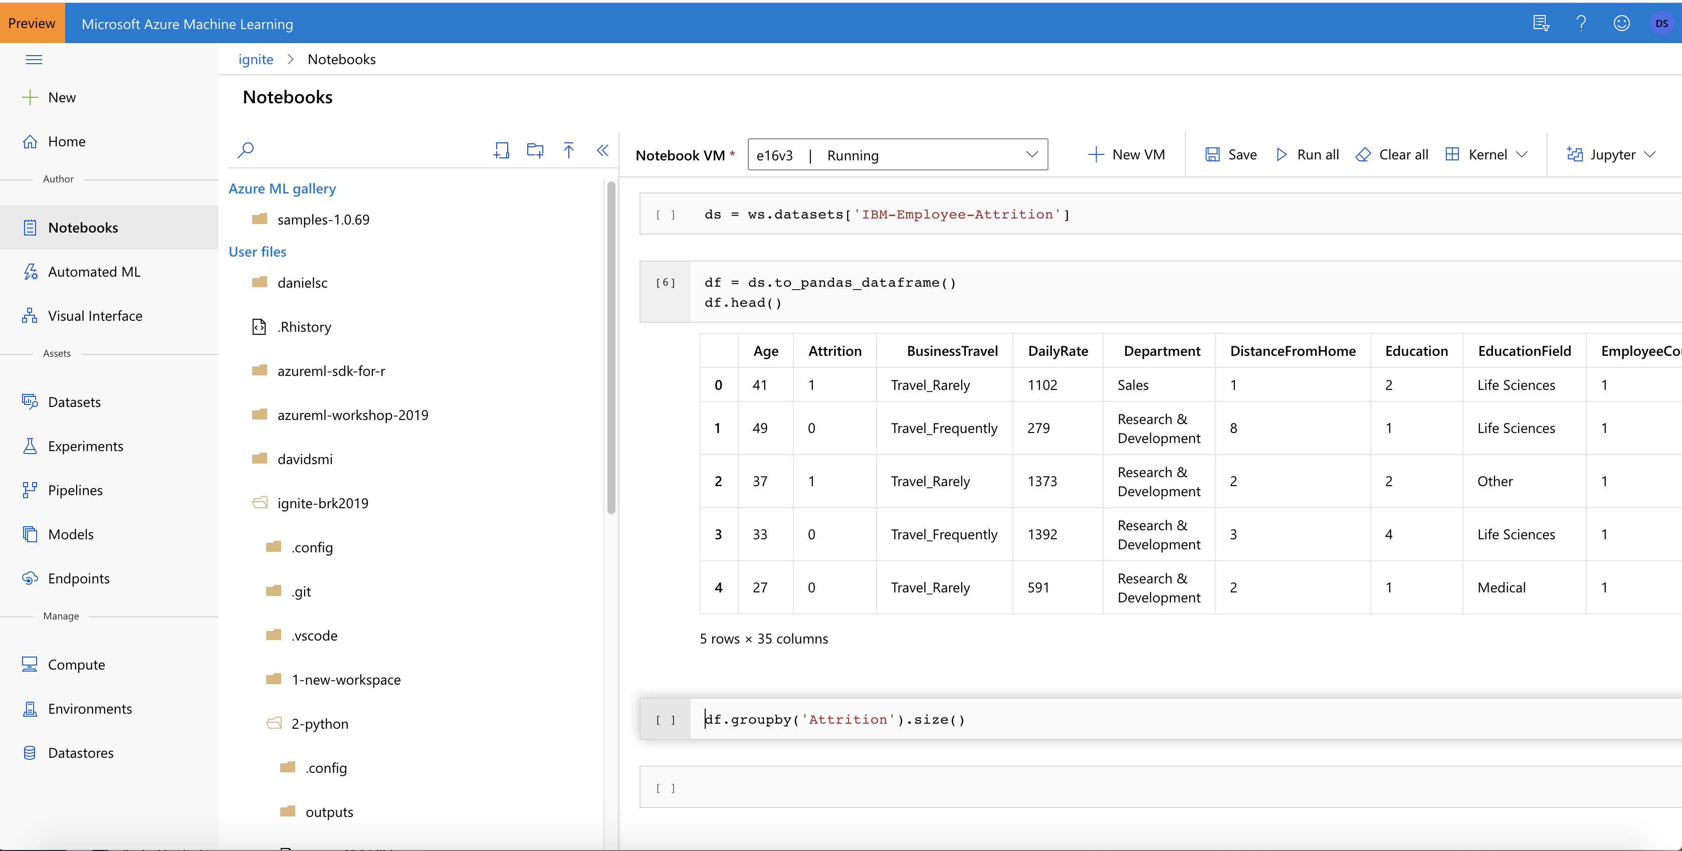
Demo: Azure ML studio (Preview)
Demo code at: http://aka.ms/brk2019
Notes:
Balance slide – 3 pillars – why most compelling – FIX IMAGE/SLIDE
Productivity – automated ML, user GUI
E2e – ML ops,
Open plat – ONNX runtime MLFlow

Slide 4
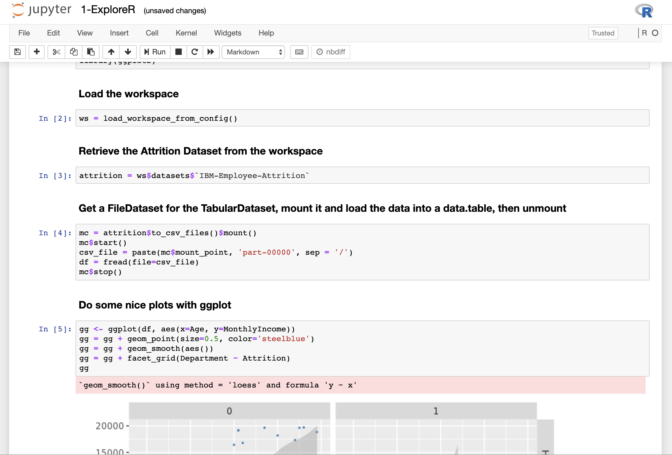
Demo: Azure ML and R
Demo code at: http://aka.ms/brk2019
Notes:
Balance slide – 3 pillars – why most compelling – FIX IMAGE/SLIDE
Productivity – automated ML, user GUI
E2e – ML ops,
Open plat – ONNX runtime MLFlow

Slide 5

Datasets
Typed references to data residing on a Datastore
Datastores: Blob, SQL, ADLS g1/g2, HTTP
Types: Tabular Datasets & File Datasets
Provide consistent access in different locations
Locations: Local machine, Compute Instance, Compute Cluster
Access: Download, Mount, Dataframe
Tracked and Versioned access
Maintains lineage of which run used which dataset
Dataset’s metadata is versioned, history is preserved
Simple to create, profile and explore
Fully integrated into AzureML studio

Slide 6
Datasets cheat sheet
Datastores
Datasets
Consumption
skip(), take(), random_split(),
drop_columns(), take_sample(),
time_after(), time_before(),
time_between(), time_recent(),
…
SQL
from_sql_query()
TabularDataset
to_pandas_dataframe()
to_spark_dataframe()
Azure Blob
File Share
ADLS g1/g2
Dataframe
from_delimited_files()
from_parquet_files()
from_json_lines_files()
to_csv_files()
to_parquet_files()
Mount
mount()
from_files()
FileDataset
HTTP/Web
Download
download()
skip(), random_split(),
take(), take_sample(),
…

Slide 7
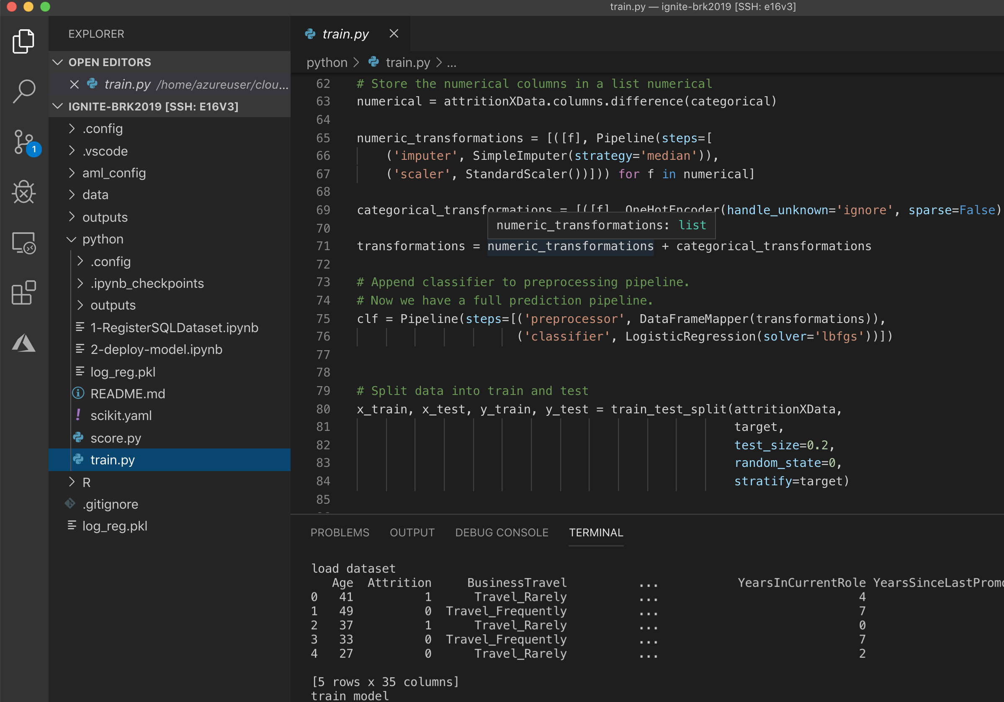
Demo: Train and Deploy Model in Python and R
Demo code at: http://aka.ms/brk2019
Notes:
Balance slide – 3 pillars – why most compelling – FIX IMAGE/SLIDE
Productivity – automated ML, user GUI
E2e – ML ops,
Open plat – ONNX runtime MLFlow

Slide 8
What we did
Created Dataset pointing to SQL data in the AzureML studio, tested it in Python
Created a Python model using the Dataset in VSCode remote running on our Notebook VM, deploy the model as a webservice
Workspace
Used the Dataset in in RStudio server running on our Notebook VM to plot some charts
Created an R model using the Dataset in RStudio server using a compute cluster and deployed it
Created a Shiny app to score both models in Rstudio server on the Compute Instance
SQL

Slide 9
Compute Instance (Preview in November 2019)
Collaborative
Share notebooks, compute instances*, files
Managed and Secure
Automated provisioning*, RBAC*, VNet*, SSH policy*, AAD-gated access
Preconfigured for ML
Python, R, GPU drivers, DL Frameworks
Fully customizable
Broad set of VM sizes (incl. GPU),
Productive
Code & Debug with Jupyter, JupyterLab, Rstudio server, VS Code
*new compared to Notebook VM

Slide 10
AzureML R SDK (Preview)
Just released on GitHub:
https://github.com/Azure/azureml-sdk-for-r
Provides a broad subset of the Python SDK
Tracking, Training, Monitoring
We welcome your feedback
Open Issues on github
Ask questions on stackoverflow. Tag: azure-machine-learning-service

Slide 11
Other session on Azure ML
Day | Time | Code | Title and speaker
Monday,11/04 | 4:30 PM- 5:15PM | BRK2020 | Creating a model factory with automated machine learning (Tzvi Keisar)
Tuesday,11/05 | 10:30 AM-11:15 AM | BRK3033 | Top 10 things to know about Azure Machine Learning technical edition (Gregory Buehrer)
 | 2:15 PM- 3:00 PM | BRK2019 | Choosing the best language for your machine learning solution: From R to Python (Daniel Schneider)
 | 3:30 PM- 4:15 PM | BRK2018 | Responsible AI: Building trustworthy, secure and transparent machine learning (Sarah Bird)
Wednesday, 11/06 | 9:00 AM - 10:15 AM | BRK1009 | Machine learning simplified: From ideation to deployment with Azure Machine Learning (Erez Barak)
 | 9:15 AM - 10:00 AM | BRK3035 | Manage your end-to-end machine learning lifecycle with MLOps (Jordan Edwards)
 | 1:00 PM-1:45 PM | BRK2017 | Understanding enterprise readiness for machine learning solutions (Aashish Bhateja)
Thursday,11/07 | 1:00 PM-1:45 PM | BRK1007 | Lessons learned from implementing real-world machine learning solutions: Common patterns and best practices (Venky Veeraraghavan)
 | 2:15 PM- 3:00 PM | BRK2184 | Machine learning on Azure: Ask me anything (Venky Veeraraghavan)
Friday, 11/08 | 11:45 AM- 12:30 PM | BRK2016 | Azure Machine Learning and open source: Designed for each other (David Aronchick)
Notes:
Is there a doc we can point people to?
Is there a magic “create workspace button” we can have people do?

Slide 12



Learn More
c
a
b
Start Free
Build, train, and deploy models with an Azure free account
https://azure.microsoft.com/free
Documentation
Dig into our technical documentation
https://aka.ms/AzureMLDocs
Give feedback
Tell us what you think, ask for a feature
https://aka.ms/AzureML_feedback

Slide 13
Invent with purpose.
Notes:
And that’s a statement around how we feel about Azure.
We want to invent with purpose in how we think about it what we deliver to you but also enable you to invent with purpose.
And we do that in some key ways.
TRANSITION: I talk about these ways as our promises to you on what Azure will always deliver and why we’ll help you.

